Slide 1
Tic-Tac-toe
By: Ben, Ben, and Ryan

Slide 2
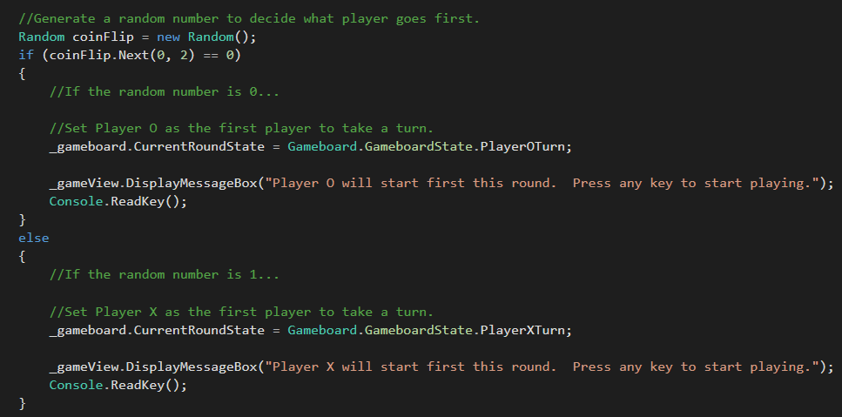
Controller.cs
Code we used to randomly generate which player goes first

Slide 3
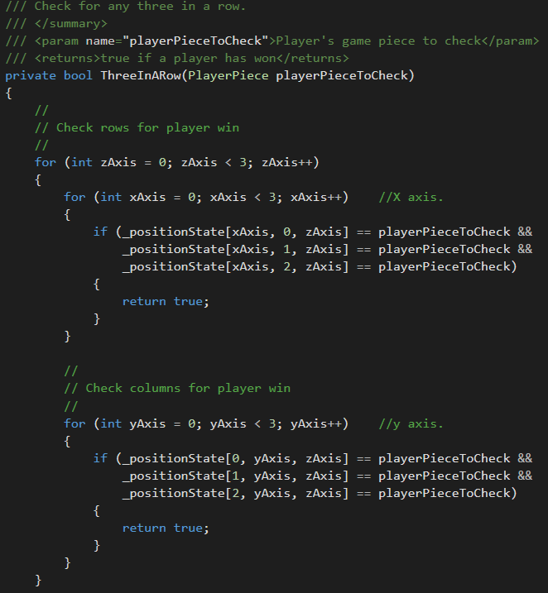
Gameboard.cs
Code we used to check for a win

Slide 4
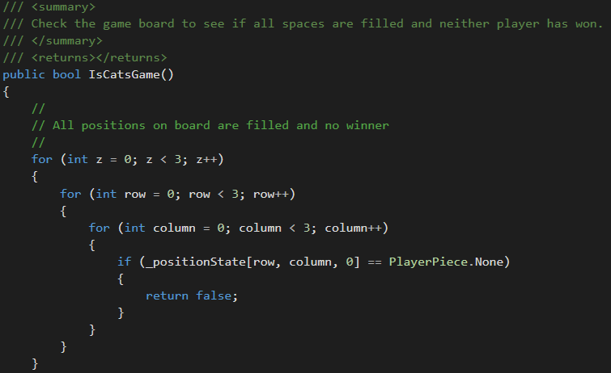
Gameboard.cs
Code to determine if it’s a cats game

Slide 5
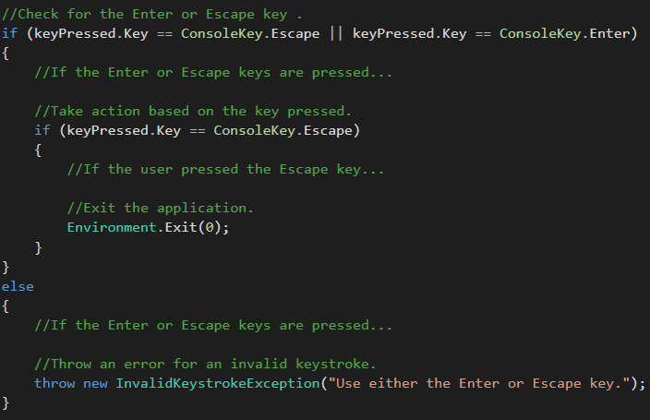
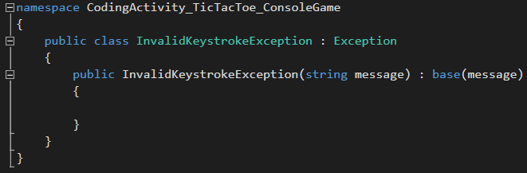
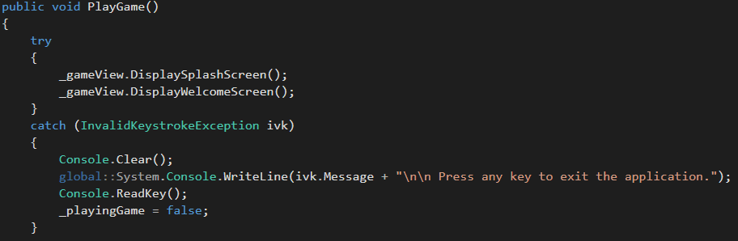
InvalidKeyStrokeException.cs
Exception rule and all cases it was used in

Slide 6
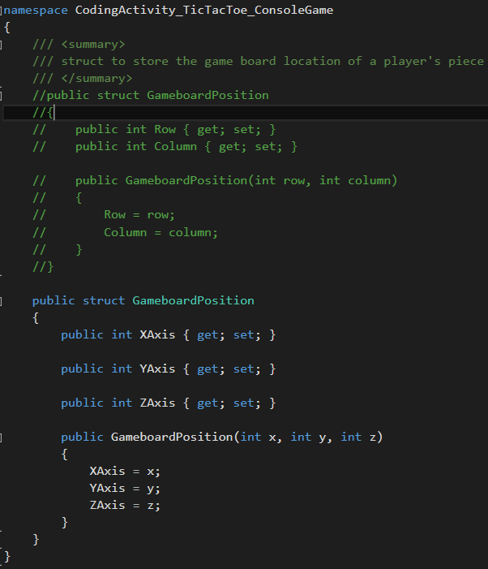
GameboadPosition.cs
Code to declare the position of the x, y, and z gameboards

Slide 7
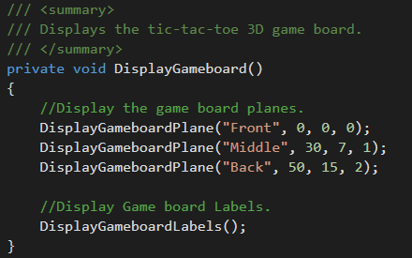
Consoleview.cs
Code that displays the coordinates of the three gameboards

Slide 8
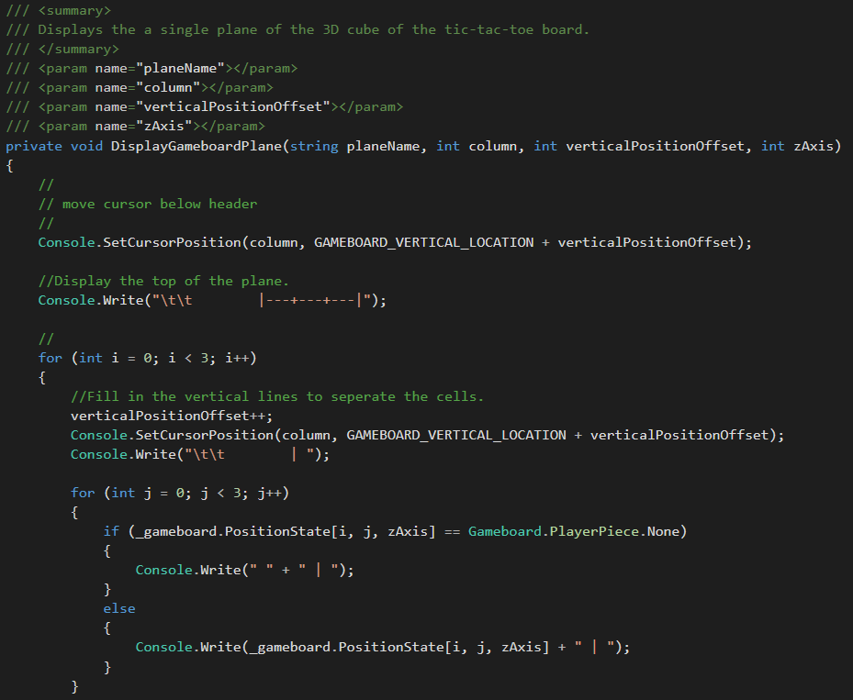
Consoleview.cs
This code displays the layout and format of the gameboards

Slide 9
Next Version
Colors throughout the game
Better graphics on the gameboards

Slide 10
What we learned
How Trello works and how to navigate through it
How to work with exceptions and how to implement them
How to use encapsulation

Slide 11
Questions?

